Slide 1
SOFTWARE ENGINEERING
Why is Software Testing Needed?
Although software testing is itself an expensive activity, yet launching of software without testing may lead to cost potentially much higher than that of testing, specially in systems where human safety is involved.
In the software life cycle the earlier the errors are discovered and removed, the lower is the cost of their removal.
Dr Prabhat Kumar Vishwakarma

Slide 2
SOFTWARE ENGINEERING
Software Testing: Definition
Testing is the process of demonstrating that errors are not present.
The purpose of testing is to show that a program performs its intended functions correctly.
Testing is the process of establishing confidence that a program does what it is supposed to do.
Testing is the process of executing a program with the intent of finding errors.
Dr Prabhat Kumar Vishwakarma

Slide 3
SOFTWARE ENGINEERING
Software Testing: Definition
  Testing requires the developers to find errors from their software.
  It is difficult for software developer to point out errors from own creations.
  Many organizations have made a distinction between development and testing phase by making different people responsible for each phase.
Dr Prabhat Kumar Vishwakarma

Slide 4
SOFTWARE ENGINEERING
General Terminologies
Error
People make errors. A good synonym is mistake. This may be a syntax error or misunderstanding of specifications. Sometimes, there are logical errors.
Bug
When developers make mistakes while coding, we call these mistakes “bugs”.
Dr Prabhat Kumar Vishwakarma

Slide 5
SOFTWARE ENGINEERING
General Terminologies
Fault
A fault is the representation of an error, where representation is the mode of expression, such as narrative text, data flow diagrams, ER diagrams, source code etc. Defect is a good synonym for fault.
Failure
A failure occurs when a fault executes. A particular fault may cause different failures, depending on how it has been exercised.
Dr Prabhat Kumar Vishwakarma

Slide 6
SOFTWARE ENGINEERING
General Terminologies
Test ,Test Case and Test Suite
Test and Test case terms are used interchangeably. In practice, both are same and are treated as synonyms. Test case describes an input description and an expected output description.
The set of test cases is called a test suite. Hence any combination of test cases may generate a test suite.
Dr Prabhat Kumar Vishwakarma

Slide 7
SOFTWARE ENGINEERING
Testing Vs Debugging
Testing | Debugging
It is the process of validating the correctness of a program.Its objective is to demonstrate that the program meets its design specification | It is the process of elliminating errors in a program.Its objective is to detect the cause of error and remove known errors in the program
Testing can begin in the early stages of software development. Although test runs of a program are carried out only after the program is coded but the decision of what to test ,how to test and with what kind of data to test can be done before the coding is started | Debugging can begin only after the program is ready
Dr Prabhat Kumar Vishwakarma

Slide 8
SOFTWARE ENGINEERING
Verification and Validation
  Verification
Verification is the process of evaluating a system or component to determine whether the products of a given development phase satisfy the conditions imposed at the start of that phase.
Validation
Validation is the process of evaluating a system or component during or at the end of development process to determine whether it satisfies the specified requirements .
Testing= Verification+Validation
Dr Prabhat Kumar Vishwakarma

Slide 9
SOFTWARE ENGINEERING
Debugging
The goal of testing is to identify errors (bugs) in the program. The process of testing generates symptoms, and a program’s failure is a clear symptom of the presence of an error. After getting a symptom, we begin to investigate the cause and place of that error. After identification of place, we examine that portion to identify the cause of the problem. This process is called debugging.
Dr Prabhat Kumar Vishwakarma

Slide 10
SOFTWARE ENGINEERING
Why Debugging?
Pressman explained few characteristics of bugs that provide some clues.
“The symptom and the cause may be geographically remote. That is, the symptom may appear in one part of a program, while the cause may actually be located in other part. Highly coupled program structures may complicate this situation.
The symptom may disappear (temporarily) when another error is corrected.
The symptom may actually be caused by non errors (e.g. round off inaccuracies).
The symptom may be caused by a human error that is not easily traced.
The symptom may be a result of timing problems rather than processing problems.
It may be difficult to accurately reproduce input conditions (e.g. a real time application in which input ordering is indeterminate).
The symptom may be intermittent. This is particularly common in embedded system that couple hardware with software inextricably.
The symptom may be due to causes that are distributed across a number of tasks running on different processors”.
Dr Prabhat Kumar Vishwakarma

Slide 11
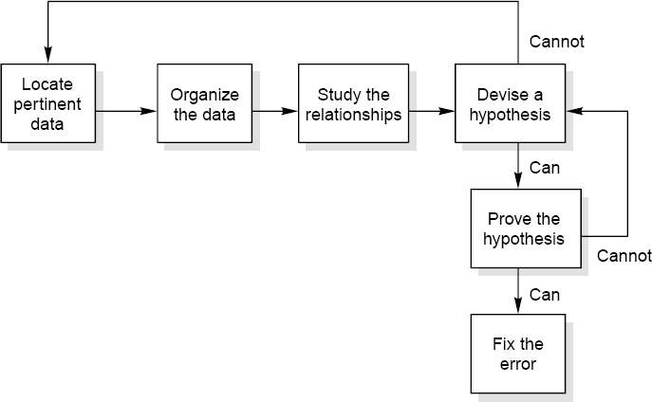
SOFTWARE ENGINEERING
Debugging Techniques
1.INDUCTIVE APPROACH
2.DEDUCTIVE APPROACH
1.INDUCTIVE APPROACH
It should be obvious that careful thought will find most errors without the debugger even going near the computer. One particular thought process is induction, where you move from the particulars of a situation to the whole. That is, start with the clues (the symptoms of the error, possibly the results of one or more test cases) and look for relationships among the clues. The induction process is illustrated as-
Dr Prabhat Kumar Vishwakarma

Slide 12
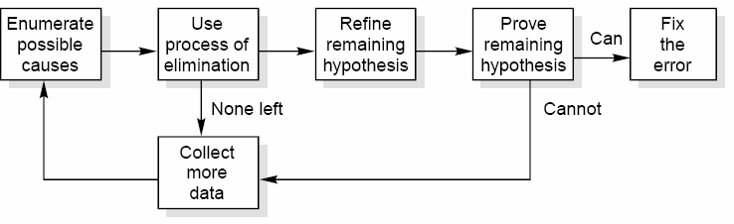
SOFTWARE ENGINEERING
Debugging Techniques
2.DEDUCTIVE APPROACH
The process of deduction proceeds from some general theories or premises, using the processes of elimination and refinement, to arrive at a conclusion (the location of the error) as illustrated below-
Dr Prabhat Kumar Vishwakarma

